Slide 1
A study of software reliability growth from the perspective of learning effects
Presented by
Basrah yousuf
ROLL NO 14
MTECH 3RD Sem

Slide 2
Introduction
Reliability growth has been studied to predict software reliability in testing/debugging phase.
Most of the models developed are based on NHPP and S shape or exponential shape type of behavior is assumed.
Efficiency in testing/debugging is not only concerned with the ability of the testing staff but also the learning effect that comes from inspecting the testing/debugging codes.
The proposed approach by chiu can reasonably describe the S-shaped and exponential-shaped types of behaviors simultaneously.
The results in the experiment show good fit.
A comparative analysis to evaluate the effectiveness for the proposed model and other software failure models has also performed

Slide 3
Software reliability growth models
Mathematical functions that describe the error detection and the removal process.
Help developers to know whether or not the code is suitable for use and how much more testing is required if it is not ready yet to release the software.
NHPP models ,model the failure occurance rate as a function of time i.e failure rate is time varying.
NHPP model assumptions include;
software faults follow NHPP

Slide 4
Contd.
the debugging process takes place immediately when an error is detected.
the software fault intensity rate at anytime is proportional to the number of remaining faults.
Unfortunately such models are suitable for particular software failure data thus narrowing the scope of their application.
NHPP models are inappropriate when nearly all of the remaining errors have become small.

Slide 5
1. Go-Model
assumption: cumulative failure process is NHPP with a simple mean value function.
Mean value fxn:
m(t)=a[ 1- exp^{(-bt})]
a>0,b>0
a= expected number of faults .
b= failure occurance rate

Slide 6
S – shaped models
2. Yamada and ohba
Delayed S shaped model.
m(t)= a (1-(1+bt) exp^{(-bt)}); b>0
3. Ohba
Inflected S shaped model
m(t)=a((1-exp^{(-bt}))/((1+c exp^{(-bt})))); a>0,b>0,c>0
c = Inflection rate

Slide 7
4. Yamada and others
Imperfect debugging model
m(t) =((ab)/(alpha+b))(exp^{(-alpha t)}-exp^{(-bt)}); a,b,alpha >0
alpha= constant failure introduction rate.
5. Pham and zang
m(t)=(1/(1+betaexp^{(-bt)}))((a+c)(1-exp^{(-bt)})-((ab)/(b-alpha))(exp^{(-alpha t)}-exp^{(-bt)}));a,b,c,alpha,beta>0

Slide 8
Alpha = constant failure introduction rate.
Beta and c are positive constants.

Slide 9
MODEL BY CHIU
the influential factors considered for finding errors in software include autonomous errors-detected factor alpha and the learning factor neta.
Interrelationship among factors;
f(t) = ( alpha + neta*F(t))(1- F(t)); alpha,neta>0
f(t) =the intensity function that denotes the fraction of
the errors detected at time t
F(t) = the cumulative function that denotes the fraction of the errors detected within time(0, t)
and 1-F(t) is the fraction of the errors as yet undetected at time t.

Slide 10
Contd.
Alpha and neta must be positive.
Mean value fxn m(t) = a F(t)
m(t)=m(t)=a(1(1+(neta/alpha))/((neta/alpha)+(exp^{((alpha+neta) t)}))).
Neta >alpha = S Shaped behaviour
Otherwise exponential.
Inflection point implies learning rate is higher than autonomous error detected rate in the process of testing or debugging.

Slide 11
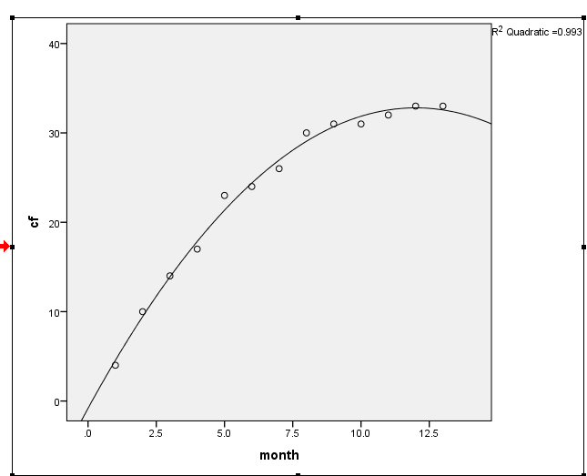
Failure data of wireless system

Slide 12
Results and comparisons
Failure data of wireless data service system
R square measure
Go model Yamada and ohba Ohba Yamada and others Pham and zang Proposed model | 0.986 0.986 0.994 0.990 0.994 0.994

Slide 13
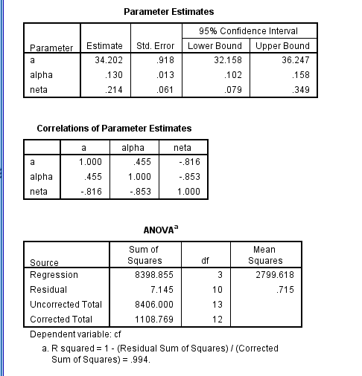

Slide 14
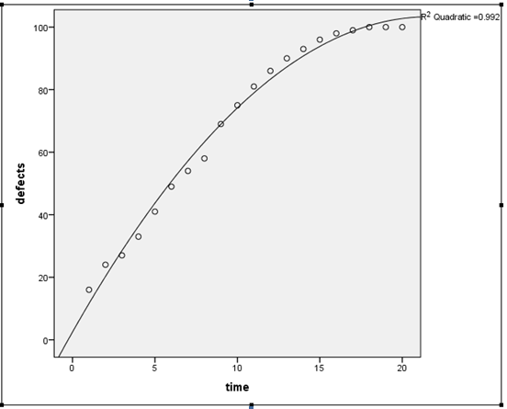
Failure data of tandem software

Slide 15
Results and comparisons
Failure data of tandem software
Go model Yamada and ohba Ohba Yamada and others Pham and zang Proposed model | 0.986 0.969 0.989 0.988 0.992 0.989

Slide 16
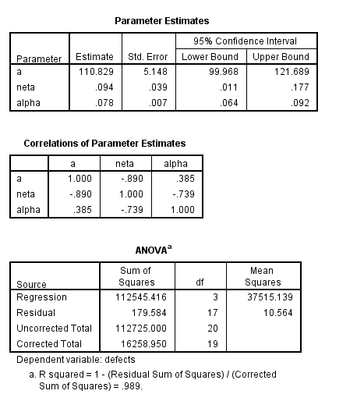

Slide 17
Conclusions
Tool used: SPSS
It can be seen that the fitting results were good for proposed model.
This can be extended to change point problems.

